Slide 1
Constructors and Destructors in Inheritance
significance of constructors and destructors in creating and managing objects, especially in the context of inheritance.

Slide 2
Overview of Constructors and Destructors
What is a Constructor?
Special member function called when an object is created.
Initializes data members.
What is a Destructor?
Special member function called when an object goes out of scope.
Cleans up resources.

Slide 3
Types of Constructors
Default Constructor
Constructor with no parameters.
Automatically called when no arguments are provided.
Parameterized Constructor
Constructor with parameters to initialize data members with specific values.
Copy Constructor
Initializes an object with a copy of another object.

Slide 4
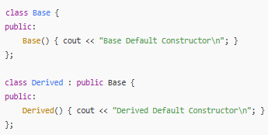
Default Constructor in Inheritance
Base Class Initialization
If a derived class does not define a constructor, the base class default constructor is automatically called.
Output Explanation: The base class constructor runs before the derived class constructor.

Slide 5

Parameterized Constructor in Inheritance
Passing Arguments to Base Class Constructor
When a derived class has a parameterized constructor, it can explicitly call the base class parameterized constructor.
Explanation:
Base(x) calls the parameterized constructor of the base class with x as an argument.

Slide 6
Constructor Call Order in Inheritance
Order of Execution
Constructors are called in the order of inheritance: Base class, then Derived class.
Takeaway: Understanding this order helps in debugging and ensures correct initialization.
Example output
Base Constructor
Derived Constructor

Slide 7
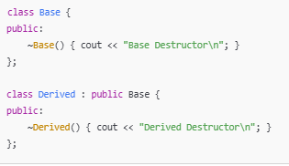
Destructor in Inheritance
What is a Destructor?
Clean-up function called automatically when an object goes out of scope or is deleted.
Destructor Order:
Destructors are called in reverse order of construction.
Example: Derived class destructor is called first, then the Base class destructor.

Slide 8
Example Code
Demonstration of Constructor and Destructor Order

